Slide 2
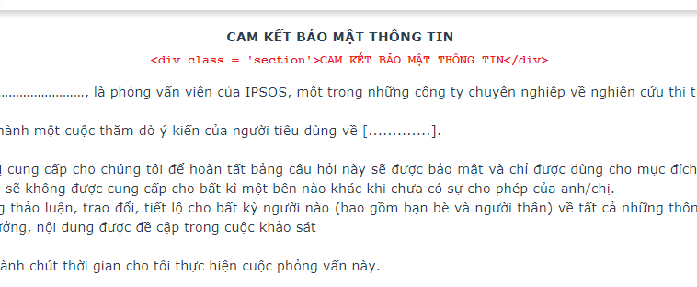
Information_Basic (Information_Basic.html)
User class ‘section’ for the title in quesion
Dimensions:
_QuestionnName "<div class = 'section'>CAM KẾT BẢO MẬT THÔNG TIN</div>
Nội dung …………………………………………………………."
templates(
Question = "htmls/Information_Basic.html"
)
info;

Slide 3
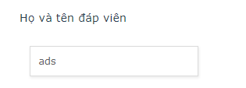
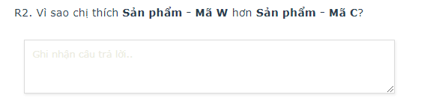
OpenEnd_Basic (OpenEnd_Basic.html)
Dimensions:
_QuestionnName “Họ và tên đáp viên”
style(
Control(
Type = "SingleLineEdit"
)
)
Templates(
Question = "htmls/OpenEnd_Basic.html"
)
text [1..];
Dimensions:
_QuestionnName “Vì sao bạn thích sản phẩm A hơn sản phẩm B?"
Templates(
Question = "htmls/OpenEnd_Basic.html"
)
text [1..];

Slide 4
OpenEndCustom_Basic (OpenEndCustom_Basic.html)
Property | Description |  | Ex
Type | Time |  | [Type:HH:MM]
 | Date |  | [Type:DD/MM/YYYY]
 | Number | Format with a thousands separator | [Type:0,000]
 |  | Scale - Show more decimal places with a number value | [Type:0,000.00], [Type:0000.00]
Unit | Optional. The number one |  | VND, USD, Lần, g/ml,….
Step | Optional. Increment the counter variable, apply only for time questions |  | [Step:10]
Range | Optional. The set of values, apply only for date questions |  | [Range:2015-2019]

Slide 5

OpenEndCustom_Basic – Time (HH:MM)
Metadata
_QuestionnName "Chị vui lòng cho biết thời gian mặc vào"
style(
Control(
Type = "SingleLineEdit"
)
)
templates(
Question = "htmls/OpenEndCustom_Basic.html"
)
text [1..];
Script
SendCustomPropertiesToBrowser(_QuestionnName, "[Type:HH:MM]#[Step:10]")
_QuestionnName.Ask()

Slide 6

OpenEndCustom_Basic – Date DD/MM/YYYY
Metadata
_QuestionnName "Xin cho biết ngày sinh của con bạn?"
style(
Control(
Type = "SingleLineEdit"
)
)
templates(
Question = "htmls/OpenEndCustom_Basic.html"
)
text [10..10];
Script
SendCustomPropertiesToBrowser(_QuestionnName, "[Type:DD/MM/YYYY]#[Range:2017-2018]")
_QuestionnName.Ask()

Slide 7

OpenEndCustom_Basic – Currency 0,000.00
Metadata
_QuestionnName "Thu nhập của hộ gia đình?"
templates(
Question = "htmls/OpenEndCustom_Basic.html"
)
double [1000 .. ];
Script
SendCustomPropertiesToBrowser(_QuestionnName, "[Type:0,000.00]#[Unit:VND]")
_QuestionnName.Ask()

Slide 8
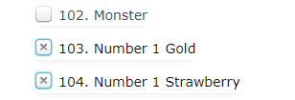
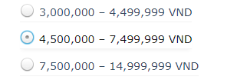
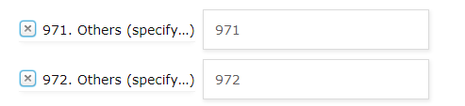

Categorical_DefaultIcons (Categorical_DefaultIcons.html)
Multi-answers
Dimensions:
_QuestionnName “Thu nhập hàng tháng của tất cả mọi người trong gia đình bạn là khoảng bao nhiêu?”
Templates(
Question = "htmls/Categorical_DefaultIcons.html"
)
categorical[1 .. 1]
{
//--Categories List--
};
Single-answers
Other categories (Before – After selected)

Slide 9
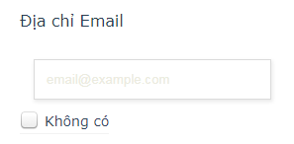
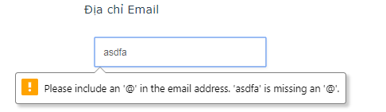
Email_Basic (Email_Basic.html)
Before – After enter and click Next Button
Dimensions:
_QuestionnName “Địa chỉ Email”
style(
Control(
Type = "SingleLineEdit"
)
)
Templates(
Question = "htmls/Email_Basic.html"
)
text [1..]
codes(
{
NoEmail "Không có"
} );

Slide 10
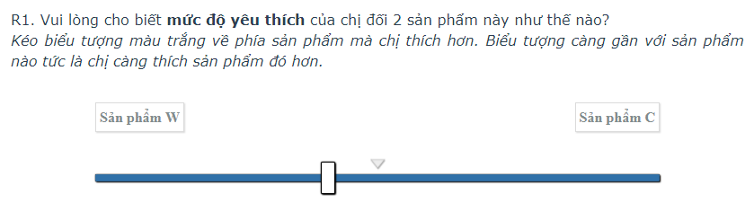
Slider Balance (Slider_Balance.html)
Objective:
var objSlider = {
productName_1 : “Sản phẩm 1”,
productName_2 : “Sản phẩm 2”,
minValue : -50,
maxValue : 50,
defaultValue : 0
};
Dimensions:
_QuestionnName “Vui lòng cho biết mức độ yêu thích của chị đối với 2 sản phẩm như thế nào?”
Templates(
Question = "htmls/Slider_Balance.html"
)
long[-50 .. 50];
SendCustomPropertiesToBrowser(_QuestionnName, “[productName_1:Sản phẩm 1]#[productName_2:Sản phẩm 2]#[minValue:-50]#[maxValue=50]#[defaultValue:0]”)
_QuestionnName.Ask()

Slide 11
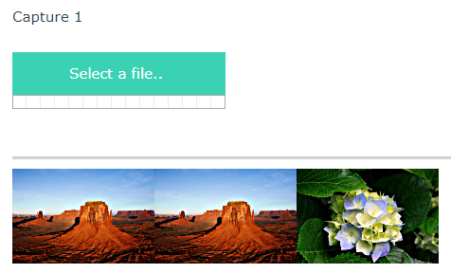
Capture_Basic (Capture_Basic.html)
Dimensions:
_QuestionnName “Capture”
style(
Control(
Type = "SingleLineEdit"
)
)
Templates(
Question = "htmls/Capture_Basic.html"
)
text[1 .. ];
dim image_name
image_name = UCase(_ProjectName.Response.Value) + UCase(_QuestionnName.QuestionName) + “_” + CText(IOM.Info.RespondentID)
SendCustomPropertiesToBrowser(_QuestionnName, “[ProjectName:{#_ProjectName}]#[ImageName:" + CText(image_name) + "]#[CloudinaryName:ipsos-longlh123]#[CloudinaryAPIKey:729957246122992]#[CloudinaryAPISecret:PbeZ3UBcBuTYQb-wCxGSG9-C5OM]”)
_QuestionnName.Ask()
Properties:
ProjectName
ImageName
CloudinaryName
CloudinaryAPIKey
CloudinaryAPISecret

Slide 12
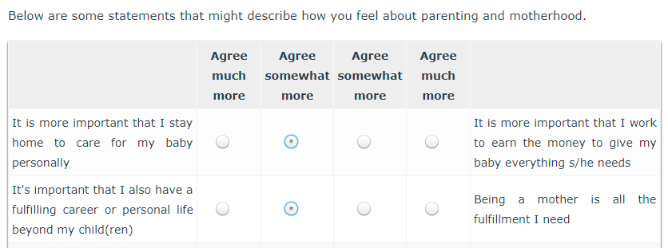
Grid_Bipolar (Grid_Bipolar.html)
Format attributes: Attr “[Attribite 1a][Attribite 1b]”
Dimensions:
_Grid_Pibolar "Below are some statements that might describe how you feel about parenting and motherhood."
templates(Question = "htmls/Grid_Bipolar.html")
loop
{
R1 "[It is more important that I stay home to care for my baby personally][It is more important that I work to earn the money to give my baby everything s/he needs]",
R2 "[It's important that I also have a fulfilling career or personal life beyond my child(ren)][Being a mother is all the fulfillment I need]"
}fields
(
_Grid_Pibolar_Codes "Grid_Pibolar_Codes"
categorical [1..1]
{
_1 "Agree much more" [value = "1"] keycode("1") factor(1),
_2 "Agree somewhat more" [value = "2"] keycode("2") factor(2),
_3 "Agree somewhat more" [value = "3"] keycode("3") factor(2),
_4 "Agree much more" [value = "4"] keycode("4") factor(1)
}axis("{..,Mean() [Decimals=2], StdDev() [Decimals=2]}");
)expand grid;

